Slide 1

INSTITUTE - UIE
DEPARTMENT- ACADEMIC UNIT-2
Bachelor of Engineering (Computer Science & Engineering)
Subject Name: Introduction to Problem Solving
Code:22CSH-101
Introduction to Problem Solving
DISCOVER . LEARN . EMPOWER

Slide 2


Introduction to Problem Solving
Course Objectives
The course aims to provide exposure to problem-solving through programming.
The course aims to raise the programming skills of students via logic building capability.
With knowledge of C programming language, students would be able to model real world problems.

Slide 3



Course Outcomes
CO Number | Course Outcome
CO1 | Remember the concepts related to fundamentals of C language, draw flowcharts and write algorithm/pseudocode.
CO2 | Understand the way of execution and debug programs in C language.
CO3 | Apply various constructs, loops, functions to solve mathematical and scientific problem.
CO4 | Analyze the dynamic behavior of memory by the use of pointers.
CO5 | Design and develop modular programs for real world problems using control structure and selection structure.

Slide 4
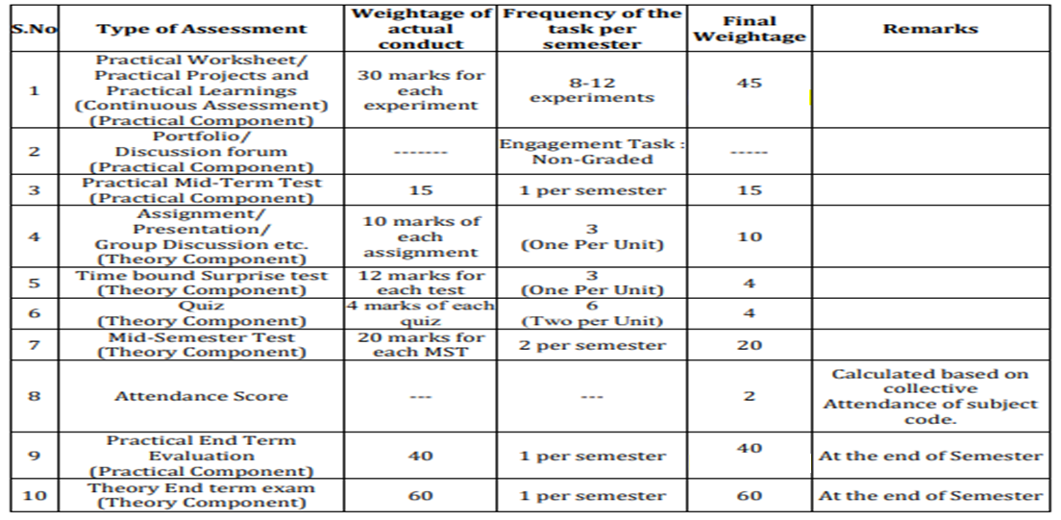
Scheme of Evaluation

Slide 5
What
An algorithm is a set of instructions designed to perform a specific task, In computer programming, algorithms are often created as functions. These functions serve as small programs that can be referenced by a larger program
Why
Algorithms are a very important topic in Computer Science because they help software developers create efficient and error free programs.

Slide 6
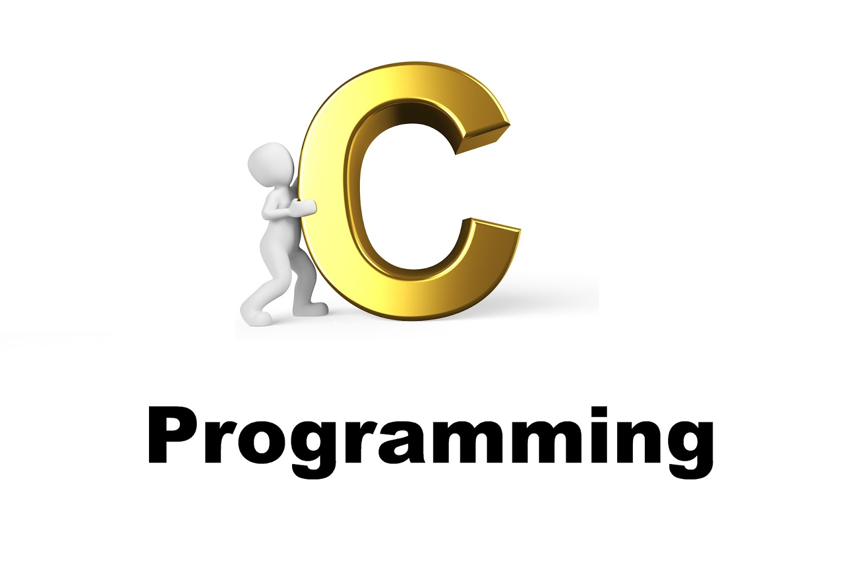
CONTENTS
Space for visual (size 24)
Introduction to C Programming
Features of C programming
Algorithms
Notes:
Computer in the diagram is 3rd generation computer. The period of third generation was from 1965-1971. The computers of third generation used Integrated Circuits (ICs) in place of transistors. A single IC has many transistors, resistors, and capacitors along with the associated circuitry. The main features of third generation are −
IC used
More reliable in comparison to previous two generations
Smaller size
Generated less heat
Faster
Lesser maintenance
Costly
AC required
Consumed lesser electricity
Supported high-level language

Slide 7
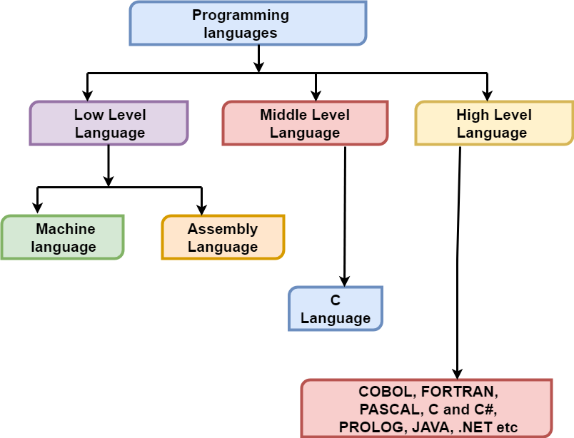
Programming Language
The language, through which user can interact with computer is known as computer language or programming language.

Slide 8
Types of Programming language:
Machine language is the low level programming language. Machine language can only be represented by 0s and 1s, it is a collection of binary digits or bits that the computer reads and interprets directly
In earlier when we have to create a picture or show data on the screen of the computer then it is very difficult to draw using only binary digits(0s and 1s). For example: To write 120 in the computer system its representation is 1111000. So it is very difficult to learn.
To overcome this problem the assembly language is invented.

Slide 9
Assembly language is the more than low level and less than high-level language so it is intermediary language. Assembly languages use numbers, symbols, and abbreviations instead of 0s and 1s.For example: For addition, subtraction and multiplications it uses symbols likes Add, Sub and Mul, etc.
High-level languages are designed to be used by the human operator or the programmer. They are referred to as "closer to humans." In other words, their programming style and context is easier to learn and implement than low-level languages
Examples of high-level programming languages in active use today include Python, Visual Basic, Delphi, Perl, PHP, ECMAScript, Ruby, C#, Java and many others.

Slide 10
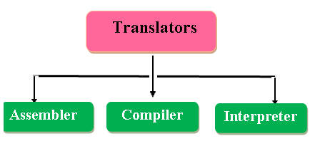
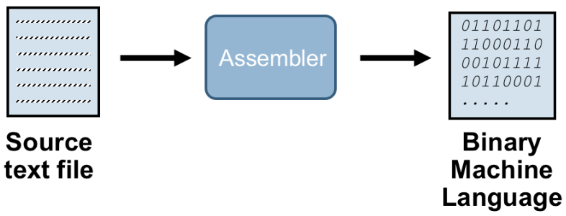
Language Translator:
Job of Assembler:

Slide 11
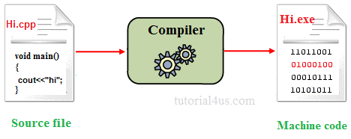
Compiler & interpreter
Compiler transforms code written in a high-level programming language into the machine code, at once, before program runs, whereas an Interpreter coverts each high-level program statement, one by one, into the machine code, during program run.
Compiled code runs faster while interpreted code runs slower.

Slide 12
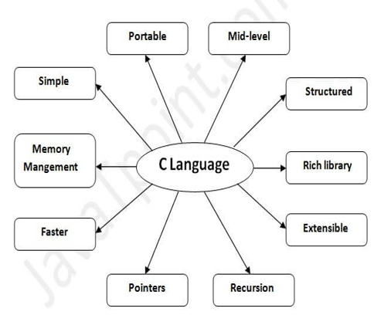
C language
C is a structured programming language. It was initially developed by Dennis Ritchie in the year 1972. It was mainly developed as a system programing language to write an operating system.
Features of C language:

Slide 13
Structured programming language :C is a structured programming language in the sense that we can break the program into parts using functions. So, it is easy to understand and modify. Functions also provide code reusability.
Portability: C language is lavishly portable as programs which are written in C language can run and compile on any system with either none or small changes.
Fast and Efficient: Programs Written in C are efficient and fast because of its variety of data type and powerful operators.
Mid-level programming language: As it is a middle-level language so it has the combined form of both, capabilities of assembly language and features of the high level language.
Rich set of built-in Operators: It is a diversified language with a rich set of built-in operators which are used in writing complex or simplified C programs.

Slide 14
Libraries with rich functions: C provides a lot of inbuilt functions that make the development fast.
Memory Management: It supports the feature of dynamic memory allocation. In C language, we can free the allocated memory at any time by calling the free() function.
Pointer: C provides the feature of pointers. We can directly interact with the memory by using the pointers.
Recursion: In C, we can call the function within the function. It provides code reusability for every function. Recursion enables us to use the approach of backtracking.
Easy to Extend: Programs written in C language can be extended means when a program is already written in it then some more features and operations can be added into it.

Slide 15
ALGORITHM
An algorithm is a series of instructions for carrying out an operation or solving a problem.
It is important to write computer programs without any logical error to generate the proper output, so it is recommended that the programmer prepare a rough design to solve the problem by showing the steps involved in the program. This is called algorithm.
In simple words, an algorithm is a step by step procedure to describe the solution of a particular problem.
Let’s take a real-world example, a simple algorithm to make a coffee! So, what are the steps involved in making a Tea? Let’s write down all the steps one by one.

Slide 16
Characteristics of Algorithm
Finiteness: Any algorithm should complete at one particular time and this is very important for any algorithm otherwise your algorithm will go in infinite state and it will not complete ever.
Definiteness: Each algorithm should be clear and unambiguous.
Effectiveness: Each line of an algorithm should be essentials. We should try to write in a simple way so it would be basic.
Input: Every algorithm should take input it can be Zero or one or more. So according to the conditions user can use.
Output: For any work some output should come, this is must otherwise there is no meaning of any work. In the same way, each algorithm should generate one or more output.
Generality: The algorithm should be common for the set of input and requirements so the same algorithm can apply in multiple places according to the user’s requirements.

Slide 17

ALGORITHM TO MAKE TEA
Step 1- Start
Step 2-Take a cup and tea bag
Step 3-Put the teabag in cup.
Step 4-Fill the kettle with water.
Step 5-Boil the water for few seconds
Step 6-Pour some of the boiled water into the cup.
Step 7-Add milk to the cup.
Step 8-Add required sugar to the cup.
Step 9- Stir the cup for few seconds and the tea is ready
Step 10- Stop

Slide 18
Example: Add Two Numbers
Step 1 Start
Step 2 Accept or Read number1
Step 3 Accept or Read number2
Step 4 Add number1 and number2 and store the result in sum
Sum=number1+number2
Step 5 Display sum
Step 6 Stop
Inputs
Process
Output

Slide 19
Example: Calculate area of Rectangle
STEP 1 : Start
STEP 2 : Read W of Rectangle
STEP 3 : Read h of Rectangle
STEP 4 : calculate area
Area = w × h
STEP 5 : Display Area
STEP 6 : Stop

Slide 20
CALCULATE INTEREST OF BANK DEPOSIT
Step 1: Start
Step 2: Read Amount
Step 3: Read Years
Step 4: Read Rate
Step 5: Calculate the interest with formula Interest=Amount*Years*Rate/100
Step 6: Display interest

Slide 21
DETERMINE WHETHER STUDENT PASSED THE EXAM OR NOT
Step 1: Start
Step 2: Read grades of 4 courses M1, M2, M3 and M4,
Step 3: Calculate the average grade with formula "Grade=(M1+M2+M3+M4)/4"
Step 4: If the average grade is less than 60, Display "FAIL", else Display "PASS".
Step 5: Exit

Slide 22
DETERMINE WHETHER THE NUMBER IS EVEN OR ODD
Step 2: Read Number N,
Step 3: Set remainder = N modulo 2,
Step 4: If remainder is equal to 0 then Goto step 5 else Goto step 6
Step 5: Display Number N is even
Step 6: Display Number N is odd.
Step 7: Stop

Slide 23
Display your name ( 1 time & 100 times)
Step 1: Start
Step 2: Set counter=1
Step 3: Repeat steps 4 and 5 until counter<=100
Step 4: display “Aman”
Step 5: increase counter by 1
Counter=counter+1
Step 6:Stop
Step 1: Start
Step 2: Display “Aman”
Step 3: Stop
Repetition of statements(Loop)

Slide 24
Advantages of Algorithm
The algorithms are very easy to understand and can be written in simple language which can be understood by anyone
Algorithms can be broken down into different pieces, which will be easy to implement practically.
By using algorithms, we can easily understand the sequence to be followed in processing.
Disadvantages of Algorithm
Below are some main disadvantages of any algorithms:
It’s very difficult to convert the complex task into proper algorithms.
Its time-consuming process because we need to spend proper time for writing algorithm and later we need to implement in a programming language.
It’s complicated to show functionalities for each step of introduction to algorithms and it’s hard to understand each flow in the term for loop and branch.

Slide 25
Summary
In this lecture we have discussed about programming languages, need of programming language.
We have discussed about c programming language , covered some features of C and language translators.
Moreover we have learnt about algorithms , need of algorithms in programming and we have designed some algorithms
Discussed about advantages , disadvantages and applications of algorithm

Slide 26
Frequently Asked question
Q1 Where are algorithms used in real life?
Answer: In real life these algorithms are used in mp3 players, video players, making dictionaries and there are much examples for searching and sorting. Searching Algorithms is used in Quantum computing also. In Operating system scheduling of tasks is done through various algorithms such as FIFO, Round robin, etc. Google when showing search results uses page ranking techniques. Facebook when showing news feed uses a similar ranking algorithm to make it more relevant to you. All these use a modification of Link Analysis, an interesting branch in Data Mining.
So, whenever you press a key on your keyboard, make a call, perform a calculation, start an application or press a remote button, always an algorithms is triggered. So, there are countless examples of many algorithms in our daily life and making our life easier.

Slide 27
Q2 What are the various types of algorithms?
Answer: There are numerous types of algorithms designed to a particular purpose.
Recursive algorithms.
Dynamic programming algorithm.
Backtracking algorithm.
Divide and conquer algorithm.
Greedy algorithm.
Brute Force algorithm.
Randomized algorithm.
Facial recognition algorithms
Shortest Path Finding Algorithm

Slide 28
Q3 Write an algorithm to find maximum of three numbers.
Answer: Algorithm:
Step 1 : Start
Start 2 : Input a, b, c
Start 3 : if a > b goto step 4, otherwise goto step 5
Start 4 : if a > c goto step 6, otherwise goto step 8
Start 5 : if b > c goto step 7, otherwise goto step 8
Start 6 : Output "a is the largest", goto step 9
Start 7 : Output "b is the largest", goto step 9
Start 8 : Output " c is the largest", goto step 9
Start 9 : Stop

Slide 29
Assessment Questions:
1. The word ____________comes from the name of a Persian mathematician Abu Ja’far Mohammed ibn-i Musa al Khowarizmi. a) Flowchart b) Flow c) Algorithm d) Syntax
2. In computer science, algorithm refers to a special method usable by a computer for the solution to a problem. a) True b) False
3. This characteristic often draws the line between what is feasible and what is impossible. a) Performance b) System Evaluation c) Modularity d) Reliability

Slide 30
4. Which of the following is incorrect? Algorithms can be represented: a) as pseudo codes b) as syntax c) as programs d) as flowcharts
5. When an algorithm is written in the form of a programming language, it becomes a _________ a) Flowchart b) Program c) Pseudo code d) Syntax
6. Any algorithm is a program. a) True b) False
7 Design an algorithm to calculate percentage of a student for marks of 5 subjects.
8 Design an algorithm to check the given number is positive negative or zero
9 Design an algorithm to find maximum among 4 numbers
10 design an algorithm to check whether a person is eligible for vote or not.
11. Differentiate Middle level and high level language .

Slide 31
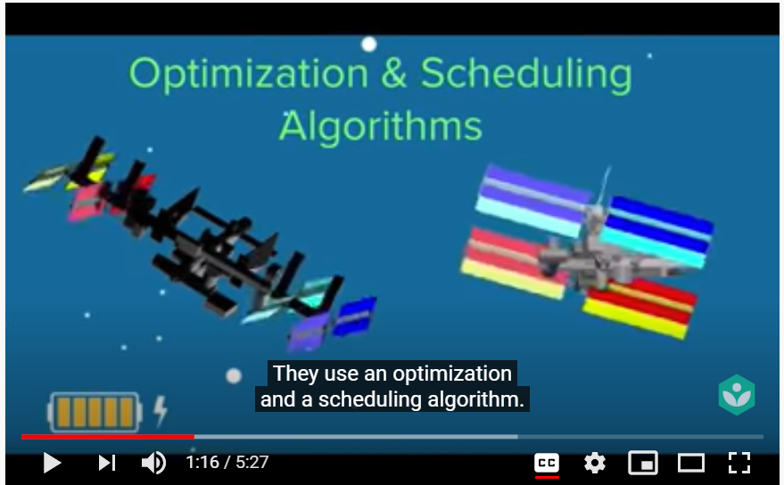
Discussion forum.
Real life applications of algorithms, students please have a look at this video and mention your views , also add some new examples
https://www.youtube.com/watch?v=CvSOaYi89B4

Slide 32

REFERENCES
Reference Books:
[1] Programming in C by Reema Thareja.
[2] Programming in ANSI C by E. Balaguruswamy, Tata McGraw Hill.
[3] Programming with C (Schaum's Outline Series) by Byron Gottfried Jitender Chhabra, Tata McGraw Hill.
[4] The C Programming Language by Brian W. Kernighan, Dennis Ritchie, Pearson education.
Websites:
https://en.wikipedia.org/wiki/Algorithm
https://fiftyexamples.readthedocs.io/en/latest/algorithms.html
https://study.com/academy/lesson/what-is-an-algorithm-definition-examples.html
YouTube Links:
What is an algorithm? https://youtu.be/6hfOvs8pY1k
Characteristics of algorithm. https://youtu.be/FbYzBWdhMb0

Slide 33
THANK YOU

